Slide 1
German Enigma Simulator
“A Cloud-Based Working Simulation for Modern Cryptography”

Slide 2
German Enigma Simulator
“A Cloud-Based Working Simulation for Modern Cryptography”
Oscar Bernal, Jim Esposito, Melony Henderson, Richard Robinson
Computer Information Systems Graduate
Program Night Students
ECPI University

Slide 3
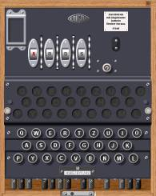
German Enigma Simulator

Slide 4
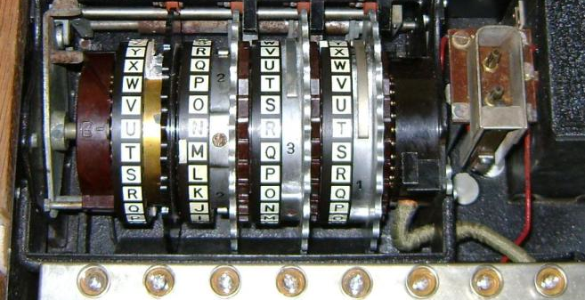
German Enigma Simulator

Slide 5
German Enigma Simulator

Slide 6
German Enigma Simulator

Slide 7
German Enigma Simulator

Slide 8
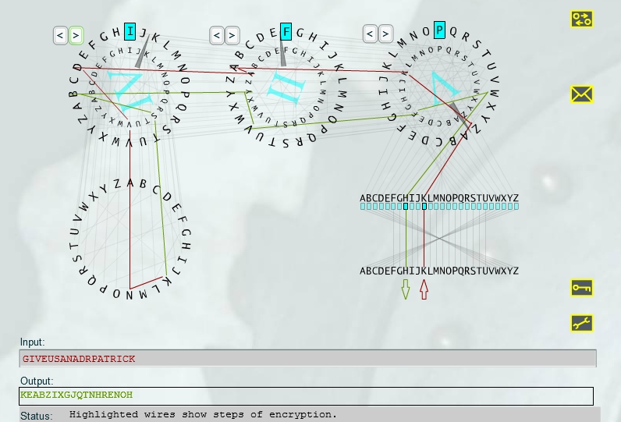
German Enigma Simulator

Slide 9
German Enigma Simulator

Slide 10
German Enigma Simulator

Slide 11
German Enigma Simulator

Slide 12
German Enigma Simulator

Slide 13
German Enigma Simulator

Slide 14
German Enigma Simulator

Slide 15
References:

